Slide 1
Section 3: Product Visibility and Marketing
Recommending the Right Products

Slide 2
Recommending the Right Products
Product recommendation systems used to target customers better
Studies have shown that personalized product recommendations improve conversion rates and customer retention rates.
As we have more data available for utilizing data science and machine learning for target marketing, the importance and effectiveness of customized product recommendations in marketing messages have grown significantly.
In this chapter, discuss the commonly used machine learning algorithms for developing recommendation systems, collaborative filtering, and the two approaches to implementing collaborative filtering algorithms for product recommendations.

Slide 3
Topics
Collaborative filtering and product recommendation
Building a product recommendation algorithm with Python
Building a product recommendation algorithm with R

Slide 4
Collaborative Filtering and Product Recommendation
According to a study conducted by Salesforce, those customers who are prompted with personalized product recommendations drive 24% of the orders and 26% of the revenue.
This signifies how much impact product recommendation has on order volume and the overall sales revenue.
In the report that Salesforce published, they have also found that product recommendations lead to repeat visits, purchases with recommendations yield higher average-order value, and customers do buy recommended items

Slide 5
Product Recommender System
A product recommender system is a system with the goal of predicting and compiling a list of items that a customer is likely to purchase.
Recommender systems have gained lots of popularity in recent years and have been developed and implemented for various business use cases.
For example, the music streaming service, Pandora, utilizes recommender systems for music recommendations for their listeners.
The e-commerce company, Amazon, utilizes recommendation systems to predict and show a list of products that a customer is likely to purchase.
The media service provider, Netflix, uses recommender systems to recommend movies or TV shows for individual users that they are likely to watch.

Slide 6
Product Recommender System
The usage of a recommender system does not stop here.
It can also be used to recommend related articles, news, or books to users.
With the potential of being used in a variety of areas, recommender systems play a critical role in many businesses, especially in e-commerce and media businesses, as they directly impact the sales revenue and user engagements.
There are typically two ways to produce a list of recommendations:
Collaborative filtering
Content-based filtering

Slide 7
Product Recommender System
The collaborative filtering method is based on previous user behaviors, such as pages that they viewed, products that they purchased, or ratings that they have given to different items.
The collaborative filtering approach then uses this data to find similarities between users or items, and recommends the most similar items or contents to the users.
The basic assumption behind the collaborative filtering method is that those who have viewed or purchased similar contents or products in the past are likely to view or purchase similar kinds of contents or products in the future.
Thus, based on this assumption, if one person purchased items A, B and C and another person purchased items A, B, and D in the past, then the first person is likely to purchase item D and the other person is likely to purchase the item C, as they share lots of similarities between them.

Slide 8
Product Recommender System
Content-based filtering, on the other hand, produces a list of recommendations based on the characteristics of an item or a user.
It typically looks at the keywords that describe the characteristics of an item.
The basic assumption behind the content-based filtering method is that the users are likely to view or purchase items that are similar to those items that they have bought or viewed in the past.
For example, if a user has listened to some songs in the past, then the content-based filtering method will recommend similar kinds of songs that share similar characteristics to those songs that the user has already listened to.
In this chapter, we are going to use a collaborative filtering algorithm to build a product recommendation system

Slide 9
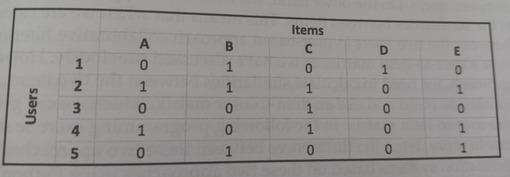
Collaborative filtering
As discussed in the previous section, a collaborative filtering algorithm is used to recommend products based on the history of user behaviors and the similarities between users.
The first step to implementing a collaborative filtering algorithm for a product recommendation system is building a user-to-item matrix.
A user-to-item matrix comprises individual users in the rows and individual items in the columns.
It will be easier to explain with an example.
Take a look at the following matrix:

Slide 10

Collaborative filtering
The rows in the matrix represent each user and the column represent each item.
The values in each cell represent whether the given user bought the given item or not
For example, user 1 has purchased items B and D and user 2 has purchased items A,B, C and E
In order to build a collaborative filtering-based product recommendation system, first build this type of user-to-item matrix
With this user-to-item matrix, the next step to building a collaborative filtering-based product recommender system is to compute similarities between users.
To measure the similarities, cosine similarity is frequently used.
The equation for computing the cosine similarity between two users looks as follows:

Slide 11
Collaborative filtering
In this equation, U₁, and U₂, represent user 1 and user 2. P_{1i} and P_{2i} represent each product i that user 1 and user 2 have bought.
By using the above equation, will get 0. 353553 as the cosine similarity between users 1 and 2 in the previous example and 0. 866025 as the cosine similarity between users 2 and 4.
As you can imagine, the larger the cosine similarity is, the more similar the two users are.
So, in our example, users 2 and 4 are more similar to each other than users 1 and 2.
Discuss how can compute cosine similarities between users using Python and R in the following programming exercise
When using a collaborative filtering algorithm for product recommendations, there are two approaches—a user-based approach and an item-based approach.

Slide 12
Collaborative filtering
User based approach collaborative filtering uses the similarities between users.
Item based approach collaborative filtering uses the similarities between items
Build and use a user-to-item matrix to calculate similarities between the two users in user based approach collaborative filtering
Build and use a item-to-user matrix for the item-based approach which is simply transposing the user-to-item matrix

Slide 13
Building a product recommendation algorithm with Python
In this section, discuss how to build a product recommendation system using Python.
More specifically, learning how to implement a collaborative filtering algorithm in Python using a machine learning library, scikit-learn.
We will start this section by analyzing some e-commerce business data and then discuss the two approaches to building a product recommendation system with collaborative filtering
For this exercise, we will be using one of the publicly available datasets from the UCI Machine Learning Repository, named Online Retail. x1sx

Slide 14
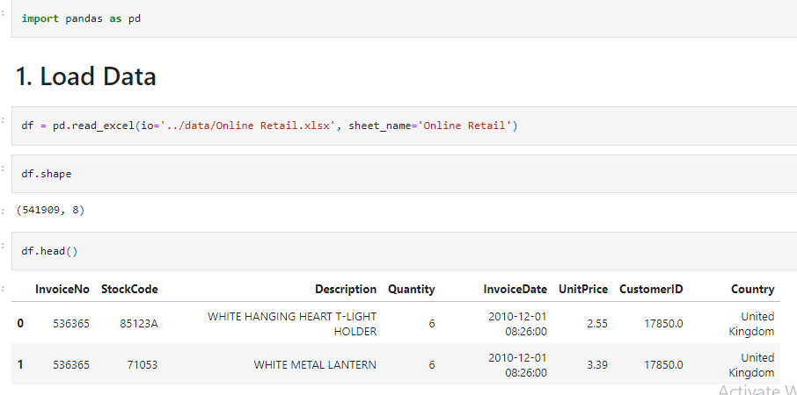
Building a product recommendation algorithm with Python

Slide 15
Building a product recommendation algorithm with Python
There are records with negative values in the Quantity column, which represent canceled orders that records can disregard and remove
Filter out all these records in DataFrame with the following code:
df = df.loc[df|'Quantity'] > 0]

Slide 16
Data preparation
Before building a product recommender engine using a collaborative filtering algorithm, do the following:
Handle NaN values in the dataset
Build a customer-to-item matrix
First, handle NaN values in dataset, especially those NaNs in the CustomerID field.
Without correct values in the Customer ID field, cannot build a proper recommendation system, since the collaborative filtering algorithm depends on the historical item purchase data for individual customers.
Second, build customer-to-item matrix before implementing the collaborative filtering algorithm for product recommendation.
The customer-item matrix is simply tabular data, where each column represents each product or item, each row represents a customer, and the value in each cell represents whether the given customer purchased the given product or not.

Slide 17

Handling NaNs in the CustomerID field
If closely look at the data, notice that there are some records with no Customer ID.
When build a customer-item matrix where each row is specific to each customer, cannot include those records with no Customer ID in the data.
First look at how many records do not have Customer ID.
Take a look at the following code:

Slide 18
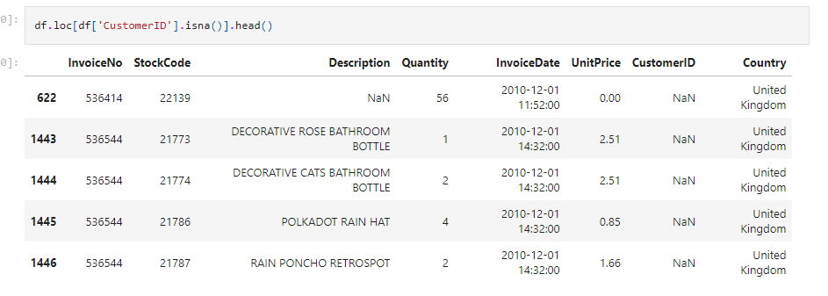
Handling NaNs in the CustomerID field
From this output, there are 133,361 records with no CustomerID.
And some of the data with missing Customer ID looks as follows:

Slide 19
Handling NaNs in the CustomerID field
One way to drop the missing records from DataFrame is by using the dropna function, as in the following:
df = df. dropna (subset=['CustomerID'])
The dropna function in the pandas package removes records with missing values from a given DataFrame.
As you can see from this code snippet, using the subset parameter, drop missing values based on specific columns.
Here, dropping records for those without Customer ID.
Once run this code, all the records in the DataFrame, df, will now have Customer ID values.
The dimensions of the DataFrame, df, before and after dropping the missing values should look as in the following screenshot

Slide 20
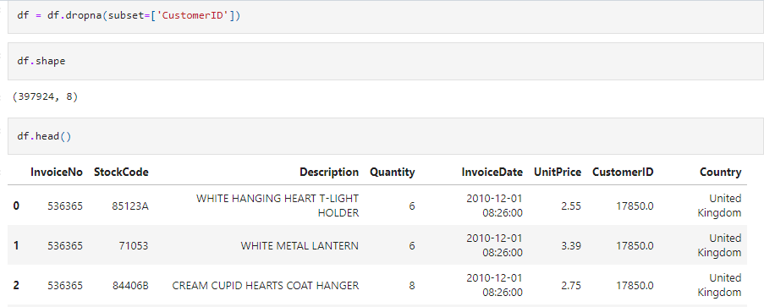
Handling NaNs in the CustomerID field
From this output, the 133,361 records with no Customer ID values were dropped from the original DataFrame.

Slide 21
Building a customer-item matrix
The data we have now represents individual items purchased by customers.
However, in order to build a product recommendation system with a collaborative filtering algorithm, we need to have data where each record contains information on which item each customer has bought.
In this section, transform the data into a customer-item matrix, where each row represents a customer and the columns correspond to different products.
From this code snippet, using the pivot_table function to transform our data into a customer-item matrix.
Here, define the index as CustomerID, and use columns to represent each StockCode.
By using sum as the aggfunc and the Quantity field for values, sum all the quantities bought for each item.
A snapshot of the resulting customer_item_matrix looks as follows:

Slide 22
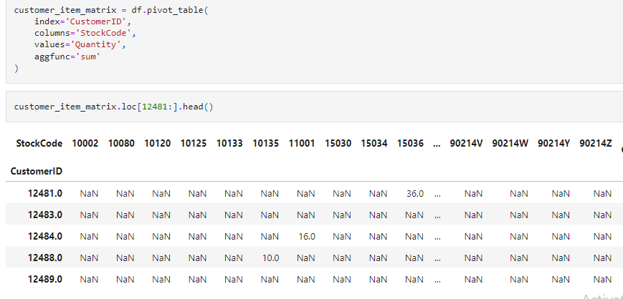
Building a customer-item matrix

Slide 23
Building a customer-item matrix
From the result, the customer with Customer ID 12481 has bought 36 of the item with StockCode 15036.
Similarly, the customer with Customer ID 12484 has bought 16 of the item with StockCode 11001, and the customer with Customer ID 12488 has bought 10 of the item with StockCode 10135.
We now have a matrix where each row represents the total quantities bought for each product for each customer.
Now, let's 0-1 encode this data, so that the value of 1 means that the given product was purchased by the given customer, and the value of 0 means that the given product was never purchased by the given customer.
From the below code, we are using the applymap function, which applies a given function to each element of a DataFrame.
The Lambda function that we are using in this code simply encodes all the elements whose values are greater than 0 with 1, and the rest with 0.
Now have a customer-item matrix that can use for the collaborative filtering algorithm.
Let's now move on to building product recommender engines.

Slide 24
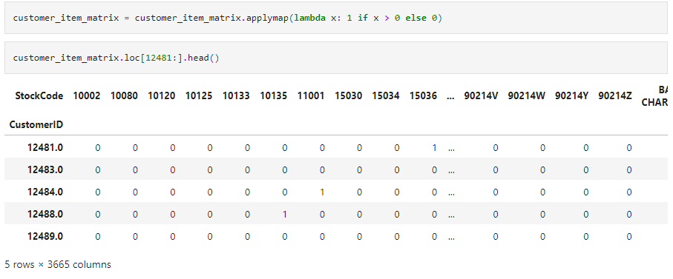
Building a customer-item matrix

Slide 25
Collaborative filtering
In this section, explore two approaches to building a product recommender engine—user-based versus item-based.
In the user-based approach, compute similarities between users based on their item purchase history.
In the item-based approach, on the other hand, compute similarities between items based on which items are often bought together with which other items.
To measure the similarity between users or between items, use the cosine_similarity method in the scikit-learn package.
Import this function using the following code:
from sklearn.metrics.pairwise import cosine_similarity
This cosine_similarity function in the sklearn package computes the pair-wise cosine similarities in the given data.

Slide 26
User-based Collaborative Filtering and Recommendations
In order to build a user-based collaborative filtering algorithm, compute cosine similarities between users.
In the code, using the cosine_similarity function from the sklearn package's metrics pairwise module.
This function computes pairwise cosine similarities between the samples and outputs the results as an array type.
Then, create a pandas DataFrame with this output array and store it into a variable named user_user_sim matrix, which stands for user-to-user similarity matrix.
The result looks as follows:

Slide 27
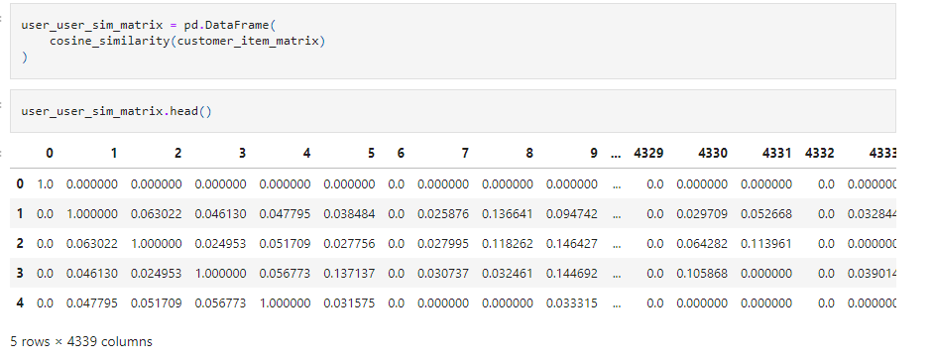
User-based Collaborative Filtering and Recommendations

Slide 28
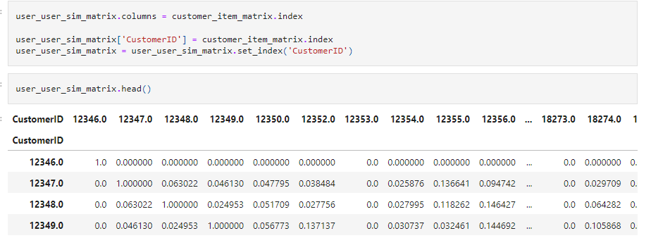
User-based Collaborative Filtering and Recommendations
From this snapshot of the user-to-user similarity matrix, the index and column names are not easy to understand.
Since each column and each row index stand for individual customers, rename the index and columns using the following code
Now the result looks as follows:

Slide 29
User-based Collaborative Filtering and Recommendations
The cosine similarity between a customer to themselves is 1.
The diagonal elements in this user-to-user similarity matrix have values of 1.
The rest represents the pairwise cosine similarity between two customers.
For example, the cosine similarity measure between customers 12347 and 12348 is 0. 063022.On the other hand, the cosine similarity between customers 12347 and 12349 is 0. 046130.
This suggests that customer 12348 is more similar to customer 12347 than customer 12349 is to the customer 12347, based on the products that they purchased.
For product recommendations, first rank the most similar customers to the customer with ID 12350, using the following code:
user_user_sim_matrix.loc[12350.0]. sort_values (ascending=False)

Slide 30
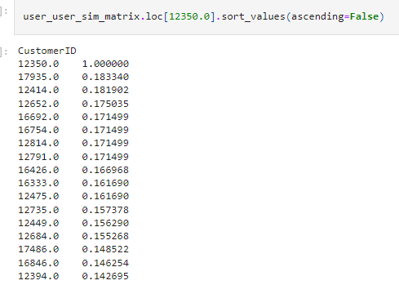
User-based Collaborative Filtering and Recommendations

Slide 31
User-based Collaborative Filtering and Recommendations
In the above output, These are the top 17 customers that are the most similar to customer 12350.
Pick customer 17935 and discuss how can recommend products using these results.
The strategy is as follows. First, identify the items that the customers 12350 and 17935 have already bought.
Then, find the products that the target customer 17935 has not purchased, but customer 12350 has.
Since these two customers have bought similar items in the past, assume that the target customer 17935 has a high chance of purchasing the items that he or she has not bought, but customer 12350 has bought.
Lastly, use this list of items and recommend them to the target customer 17935.

Slide 32


User-based Collaborative Filtering and Recommendations
First retrieve the items that the customer 12350 has purchased in the past with the below code which using the nonzero function in the pandas package.
This function returns the integer indexes of the elements that are non-zero.
Using this function on the customer_item_matrix for the given customer 12350, can get the list of items that the customer 12350 has purchased.
Apply the same code for the target customer 17935, as in the following code:

Slide 33
User-based Collaborative Filtering and Recommendations
Now we have two sets of items that customers 12350 and 17935 have purchased.
Using a simple set operation, find the items that customer 12350 has bought, but customer 17935 has not.
The code looks like the following:
items_to_recommend_to_B = items_bought_by_A - items_bought_by_B
Now the items in the items_to_recommend_to_B variable are the items that customer 12350 purchased, but customer 17935 did not purchase (yet).
Based on our assumption, these are the items that customer 17935 is likely to purchase.

Slide 34
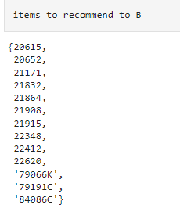
User-based Collaborative Filtering and Recommendations
The list of items to recommend to customer 17935 looks like the following:

Slide 35

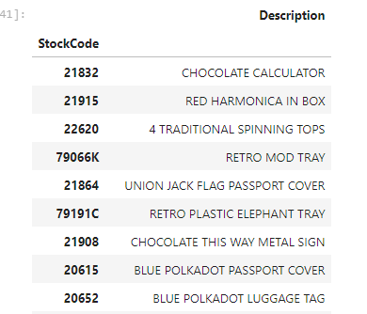
User-based Collaborative Filtering and Recommendations
In order to get the descriptions of these items, use the following code:
From this code, using the isin operator to get the records that match with the items in the items_to_recommend_to_B variable.

Slide 36
User-based Collaborative Filtering and Recommendations
Using user-based collaborative filtering, discussed how can do targeted product recommendations for individual customers.
As discussed so far, using a user-based collaborative filtering algorithm, can easily do product recommendations for target customers.
However, there is one main disadvantage of using user-based collaborative filtering.
All recommendations are based on the individual customer's purchase history.
For new customers, we are not going to have enough data to compare these new customers against the others.
In order to handle this problem, use item-based collaborative filtering

Slide 37

Item-based collaborative filtering and recommendations
Item-based collaborative filtering is similar to the user-based approach, except that it uses the similarity measures between items, instead of between users or customers.
In the previous approach, compute cosine similarities between users , but now, compute cosine similarities between items using the following code:
The only difference between these two matrices is that transposing the customer _item_matrix here, so that the row indexes represent individual items and the columns represent the customers.
Still using the cosine_similarity function of the sklearn package's metrics pairwise module.
In order to correctly name the indexes and columns with product codes, use the following code:

Slide 38
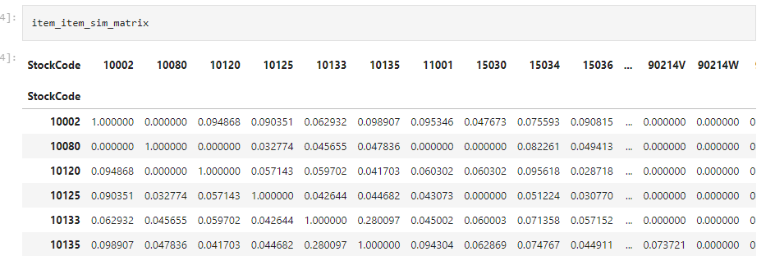
Item-based collaborative filtering and recommendations
Now the result looks as follows:

Slide 39
Item-based collaborative filtering and recommendations
As before, the diagonal elements have values of 1.
This is because the similarity between an item and itself is 1, meaning the two are identical.
The rest of the elements contain the similarity measure values between items based on the cosine similarity calculation.
For example, looking at the preceding item-to-item similarity matrix, the cosine similarity between the item with StockCode 10002 and the item with StockCode 10120 is 0.094868.
On the other hand, the cosine similarity between the item 10002 and the item 10125 is 0.090351.
This suggests that the item with StockCode 10120 is more similar to that with StockCode 10002, than the item with StockCode 10125 is to that with StockCode 10002.

Slide 40
Item-based collaborative filtering and recommendations
The strategy for doing product recommendation using this item-to-item similarity matrix is similar to what we did using the user-based approach in the previous section.
First, for the given product that the target customer bought, find the most similar items from the item-to-item similarity matrix that built.
Then recommend these similar items to the customer, since those similar items were bought by other customers who have bought the product that the target customer initially bought.
Let's work with an example. Assume a new customer just bought a product with StockCode 23166, and we want to include some products that this customer is the most likely to purchase in our marketing emails.
The first thing to do is find the most similar items to the one with StockCode 23166.

Slide 41
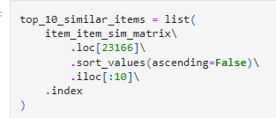

Item-based collaborative filtering and recommendations
Use the following code to get the top 10 most similar items to the item with StockCode 23166:
The result looks as follows:

Slide 42
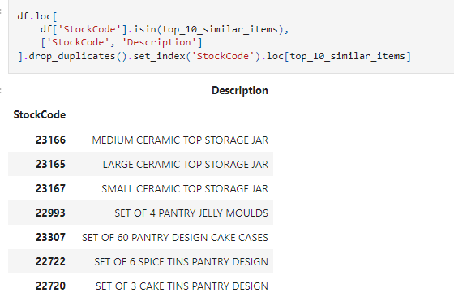
Item-based collaborative filtering and recommendations
Get the descriptions of these similar items using the following code:
From this code, the isin operator is to filter for the items that match the list of similar items in the top_10_similar_items variable.
Once run this code, get the following output:

Slide 43
Item-based collaborative filtering and recommendations
The first item here is the item that the target customer just bought and the other nine items are the items that are frequently bought by others who have bought the first item.
Those who have bought ceramic top storage jars often buy jelly moulds, spice tins, and cake tins.
With this data, include these items in marketing messages for this target customer as further product recommendations.
Personalizing the marketing messages with targeted product recommendations typically yields higher conversion rates from customers.
Using an item-based collaborative filtering algorithm, easily do product recommendations for both new and existing customers.

